Slide 1
Smart Greenhouse
First Report

Slide 2
Greenhouse Assortments

Slide 3
Greenhouse Assortments
Functional
Structure
Floor
Roof
Coverage

Slide 4
Functional
Commercial Greenhouse
Production Maximums per Unit Area
Production Despite of Seasons
Reduce Costs
Optimal Usage of Resources
Pest Control
Employment
…

Slide 5
Functional
Commercial Greenhouse
Research Greenhouse
Study and Modify on Generic Structure
Experiments
…

Slide 6
Functional
Commercial Greenhouse
Research Greenhouse
Educational Greenhouse
Teaching Gardening Skill to Students
Equipped with Features
…

Slide 7
Functional
Commercial Greenhouse
Research Greenhouse
Educational Greenhouse
Urban Greenhouse
Small Size
Well-Suited to City Spaces
Slight Product

Slide 8
Structures
Aluminum
Galvanized Steel
Wood
Plastic

Slide 9
Covers
Glass
Common
Wasting Energy
Costly
No Diffusing Light
No Heat Isolation
Breakable

Slide 10
Covers
Glass
Polycarbonate
Cheap
Durable
No Diffusing Light
No Heat Isolation

Slide 11
Covers
Glass
Polycarbonate
Polyethylene
Inexpensive
Lightweight
Easy to use
Moderately Trap Heat

Slide 12
Covers
Glass
Polycarbonate
Polyethylene
FRP )Fiberglass Reinforced Plastic(
Good Diffusing Light
‌ Breakable Against UV

Slide 13
Covers
Glass
Polycarbonate
Polyethylene
FRP )Fiberglass Reinforced Plastic(
PVC Fabric (Polyvinyl Chloride Fabric)
Resistant
UV Stabilizer
Good Diffusing Light
Easy Installation

Slide 14
Floor
Concrete
Porous Concrete
Gravel
Dirt

Slide 15
Environmental Conditions

Slide 16
The Most Important Parameters
Water
Air
Soil & Nutrients
Light
Temperature
Slope

Slide 17
Challenges in Gardening
Watering System
Light Control
Pest Control
Harvesting
Temperature & Humidity Control
Weeding
Grafting
Fertilizing

Slide 18
Plants Growing Conditions

Slide 19
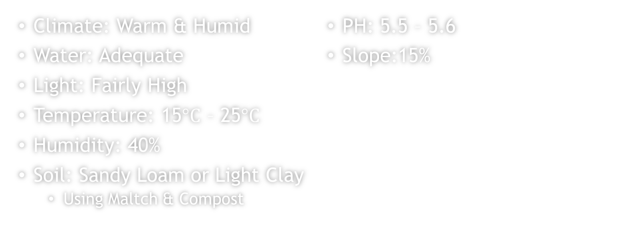
Strawberry
Climate: Warm & Humid
Water: Adequate
Light: Fairly High
Temperature: 15$°C$ – 25$°C$
Humidity: 40%
Soil: Sandy Loam or Light Clay
  Using Maltch & Compost
PH: 5.5 – 5.6
Slope:15%

Slide 20
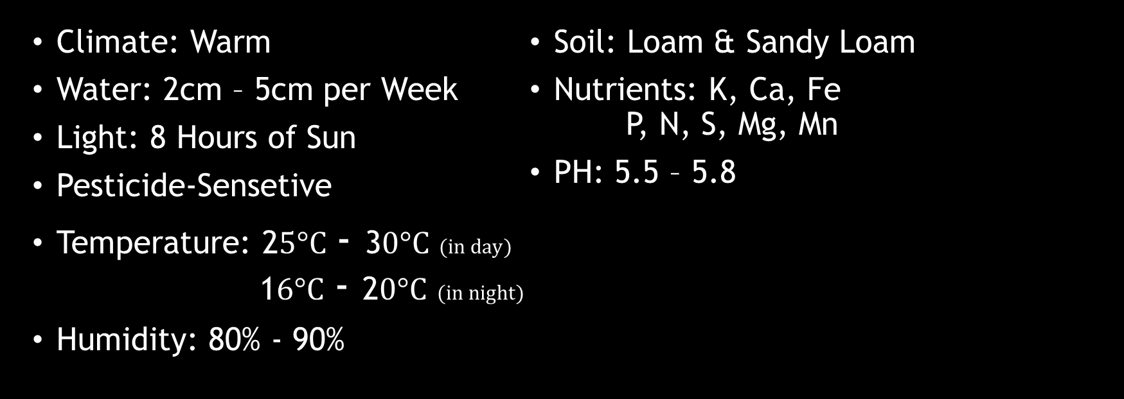
Tomato
Climate: Warm
Water: 2cm – 5cm per Week
Light: 8 Hours of Sun
Pesticide-Sensetive
Temperature: 2$5°C$ - 3$0°C$ $(in day)$ 1$6°C$ - 2$0°C$ $(in night)$
Humidity: 80% - 90%
Soil: Loam & Sandy Loam
Nutrients: K, Ca, Fe P, N, S, Mg, Mn
PH: 5.5 – 5.8

Slide 21
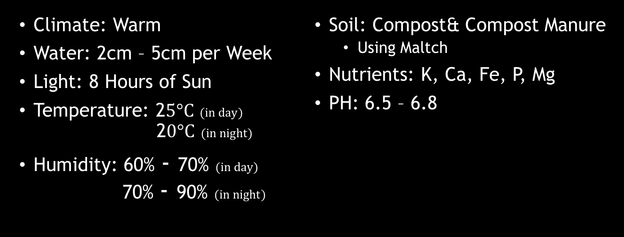
Cucumber
Climate: Warm
Water: 2cm – 5cm per Week
Light: 8 Hours of Sun
Temperature: 2$5°C$ $(in day)$ 2$0°C$ $(in night)$
Humidity: 60% - 70% $(in day)$ 70% - 90% $(in night)$
Soil: Compost& Compost Manure
  Using Maltch
Nutrients: K, Ca, Fe, P, Mg
PH: 6.5 – 6.8

Slide 22
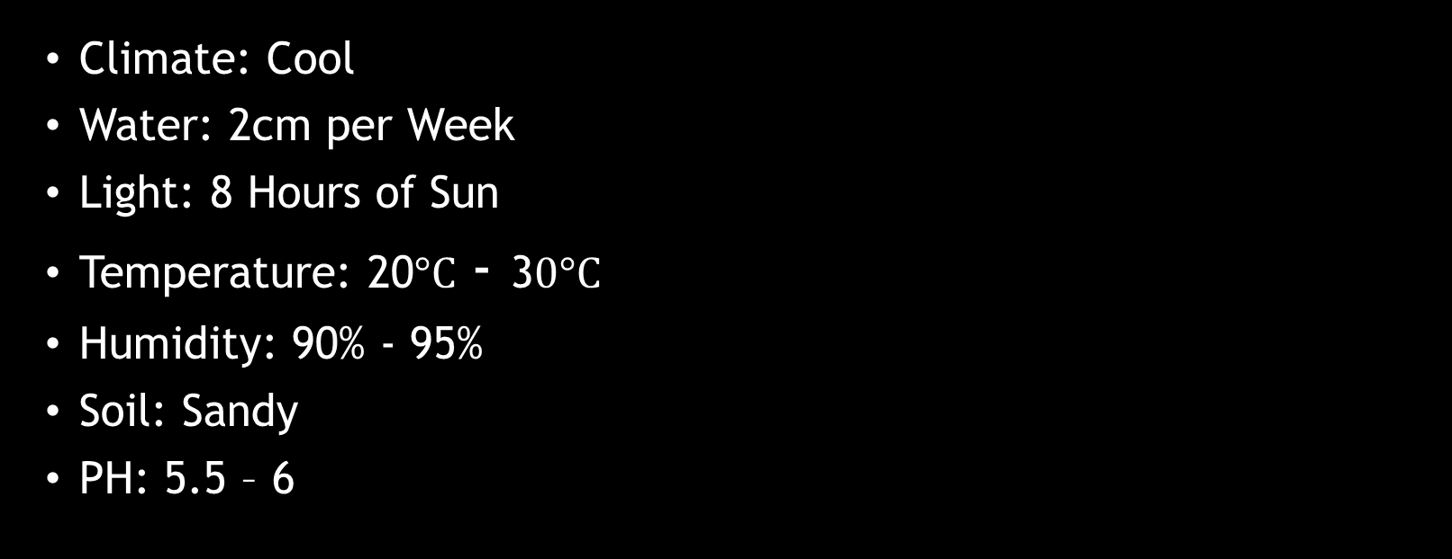
Eggplant
Climate: Cool
Water: 2cm per Week
Light: 8 Hours of Sun
Temperature: 20$°C$ - 3$0°C$
Humidity: 90% - 95%
Soil: Sandy
PH: 5.5 – 6

Slide 23
Recources
https://greenhouse.planning.solar
https://www.homedepot.com
http://www.homemadehints.com
https://insteading.com
https://www.gardeningknowhow.com
https://rokhplastic.com

